Slide 1

SMART BIOMEDICAL WASTE SEGREGATION AND MONITORING SYSTEM
👤 Prepared by - VimalRaj S
🎓 Department of Biomedical Engineering
📅 2025

Slide 2
MODULE LIST
ABSTRACT
IDEA/APPROACH DETAILS
FLOW CHART
TECH STACK AND DEPENDENCIES
METHODOLIGIES OR ALGORITHMS FOCUSED
ANALYSIS PART OF THEIR PROJECT
EXPECTED OUTCOME
SOCIAL RELEVANCE
CONCLUSION AND FUTURE WORK

Slide 3
ABSTRACT
This project presents a Smart Biomedical Waste Segregation and Monitoring System using Arduino and sensor-based automation. The system classifies waste into wet, dry, and metal categories using moisture sensors and metal detection. Automated segregation reduces human effort, minimizes contamination risks, and improves waste management efficiency in hospitals and public environments.
The system also includes secure access using Bluetooth, ensuring controlled usage.

Slide 4
IDEA/APPROACH DETAILS
Problem: Manual waste segregation → inefficient + unhygienic
Solution: Automated smart bin using sensors
Approach:
Waste placed on platform
Sensors detect type (wet/metal/dry)
Arduino processes data
Motor rotates bin accordingly
Additional Feature: Bluetooth-based access control

Slide 5
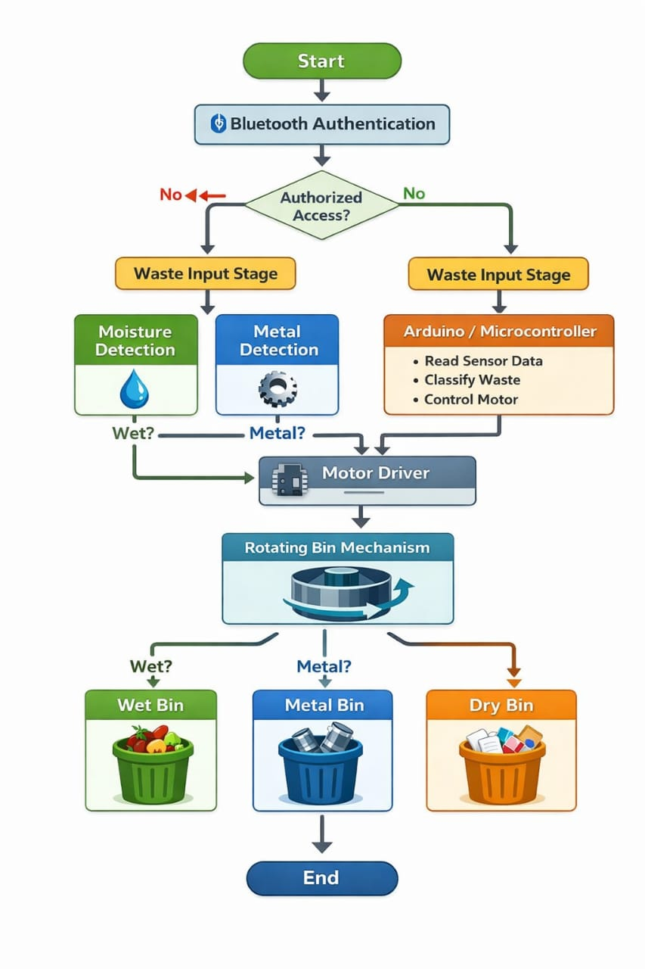
FLOW CHART
Start
Bluetooth Authentication
Check if user is authorized.
Waste Input
User places waste into the system.
Moisture Detection
Check if waste is wet.
Metal Detection
Check if waste contains metal.
Arduino Processing
Classifies waste as wet, metal, or dry.
Motor Activation
Motor rotates bin based on result.
Waste Segregation
Wet → Wet Bin
Metal → Metal Bin
Dry → Dry Bin
End

Slide 6
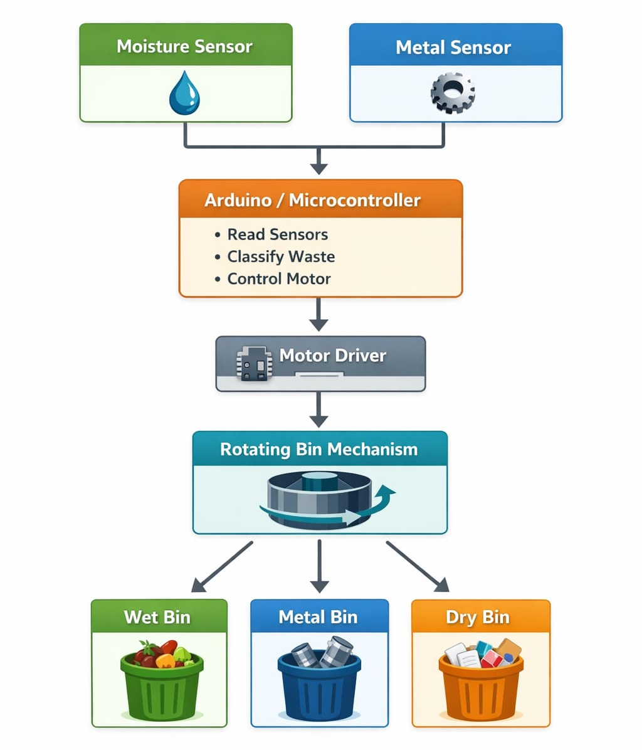

METHODOLIGIES OR ALGORITHMS FOCUSED
User Authentication
Metal Detection
Data processing by Microcontroller
Decision - making Algorithm
Motor Activation & Bin Rotation
Waste Segregation & System Reset
Waste Input Stage
Moisture Detection

Slide 7
PROPOSED SYSTEM BLOCK DIAGRAM
Proximity Switch
Power Guard
ARDUINO UNO
IR Sensor
Servo motor
Rain Drop Sensor
Stepper Motor Driver
Buzzer
Stepper motor
Waste Collecting Bin

Slide 8
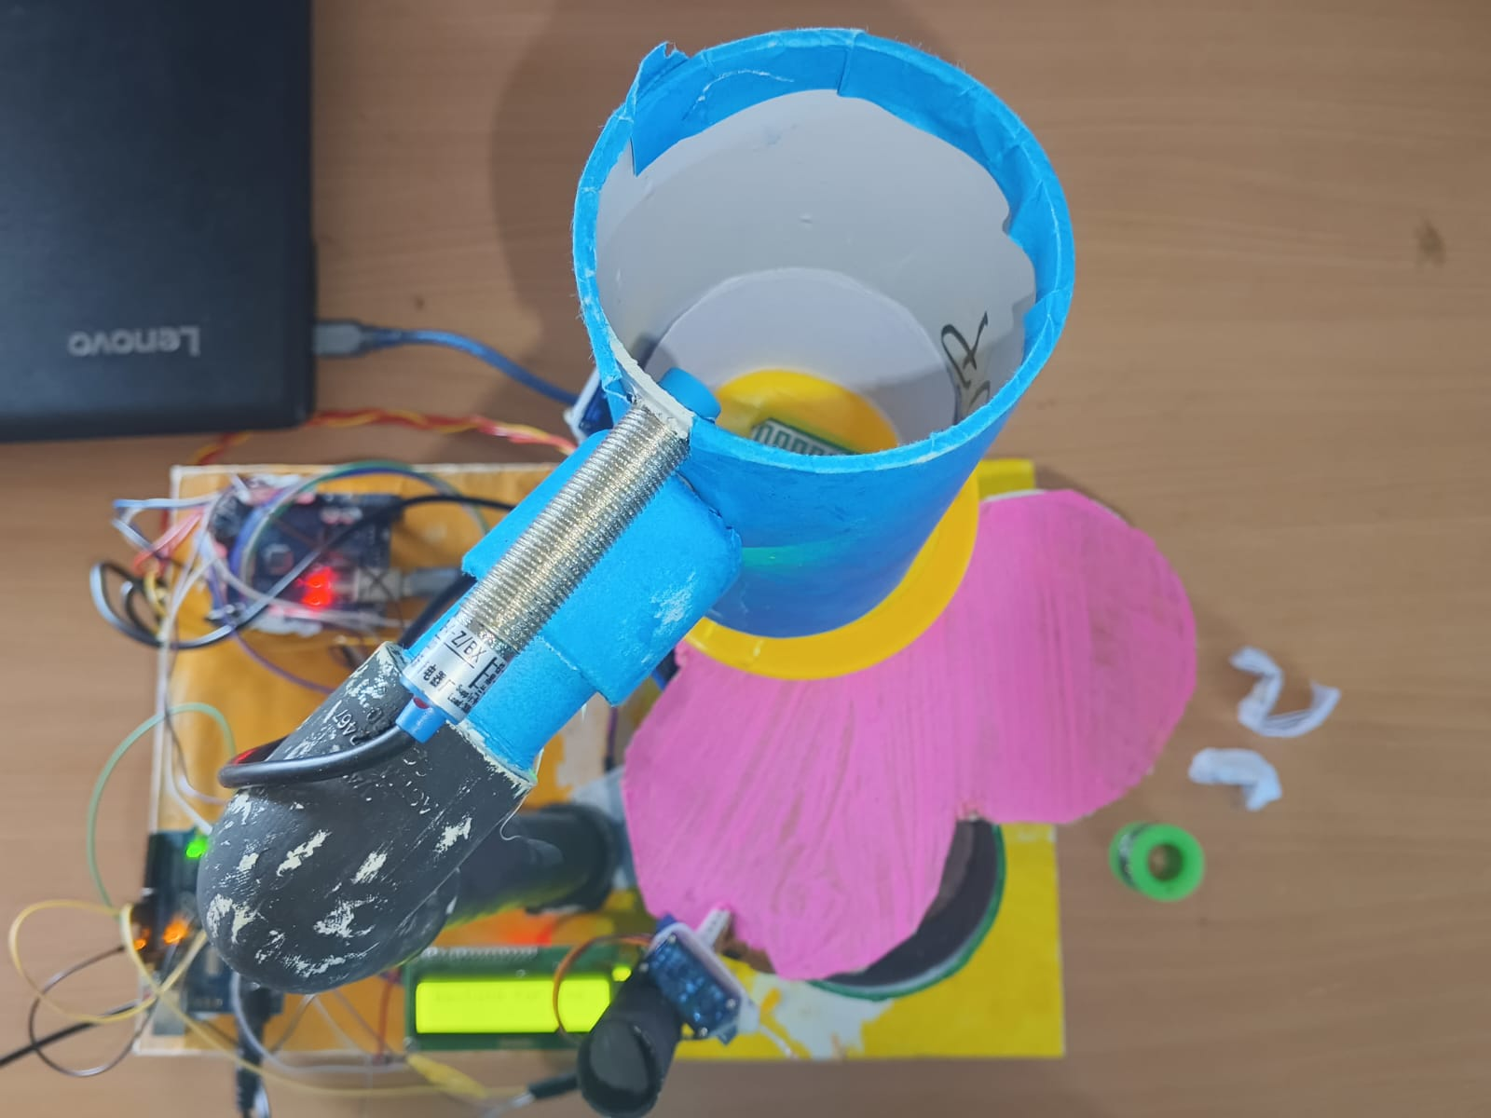
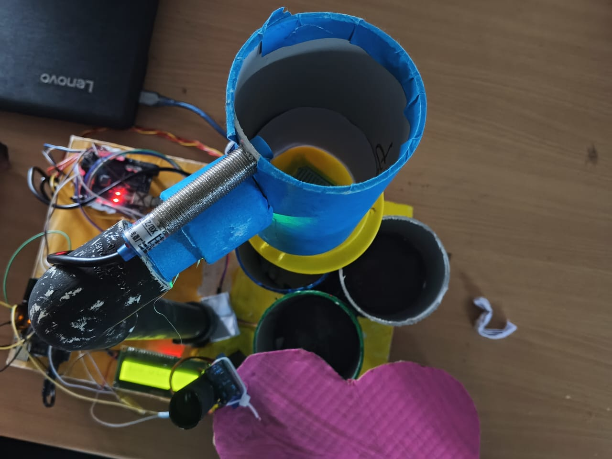
ANALYSIS OF THE PROJECT
Manual systems → error-prone, unhygienic
Existing smart bins → costly / limited features
Your system:
Low cost
Automated sorting
Secure access
Limitation:
Limited detection categories
Sensor accuracy depends on conditions
Bin Closed
Bin Opened

Slide 9
EXPECTED OUTCOME
What Our Smart Bin Can Do!
Mission Accomplished! Our automated waste segregation system is up and running — smart, secure, and efficient!
Live Testing Results:
Wet waste like food scraps? ✔️ Sorted into the wet bin
Dry waste like paper or plastic? ✔️ Sent to the dry bin
Metal items like cans? ✔️ Dropped into the metal bin
Only authorized users could open the bin with Bluetooth — ✔️ Secure access works perfectly!
Video Link: https://drive.google.com/file/d/1ikDiZNxx6a_OMCtdcxZDc6hHYQTwCNbu/view?usp=sharing

Slide 10
SOCIAL RELEVANCE
Reduces biomedical waste hazards
Prevents infection spread
Supports clean hospital environment
Promotes smart waste management
Useful in hospitals, labs, public places

Slide 11
CONCLUSION AND FUTURE WORK
CONCLUSION:
Successfully automated waste segregation
Reliable and cost-effective solution
FUTURE WORK:
Add More Waste Types
Use Image Processing (ML)
Voice Control or Touchless Interface
IoT & Cloud Connectivity

Slide 12
THANK YOU !

